Slide 1





Attention this presentation will change your mind.
It will help your bank account to save money while playing money.
Do you want to know this secret ?
Notes:
To view this presentation, first, turn up your volume and second, launch the self-running slide show.

Slide 2








Notes:
Presentations are a powerful communication medium.

Slide 3

Notes:
For more than 20 years, Duarte has developed presentations…

Slide 4



D
Notes:
…to launch products,

Slide 5














Notes:
…global causes.

Slide 6




!
My Idea
Notes:
Along the way we’ve discovered…

Slide 7
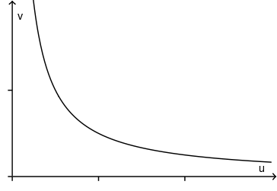
Evolution de mon compte en banque avant

Slide 8
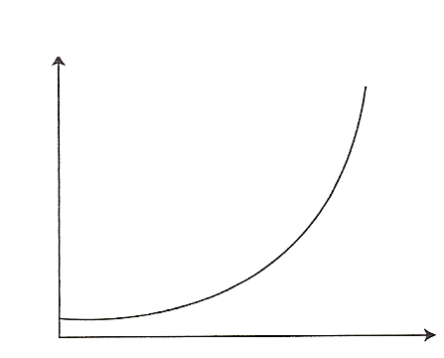
Evolution de mon compte en banque après

Slide 9
!
Saving
Money instead of
spending it while
playing a game
Notes:
…five simple rules for creating world-changing presentations.

Slide 10














Love
That
we
Idea
Notes:
…and you will undoubtedly find favor with the king.

Slide 11



